Slide 1
From open data to open algorithms… and back again A French experience
Internet Governance Forum
November 14th 2018

Slide 2
Etalab : we contribute to the state digital transformation through open data and open government
Open
Data
Open
Data

Slide 3
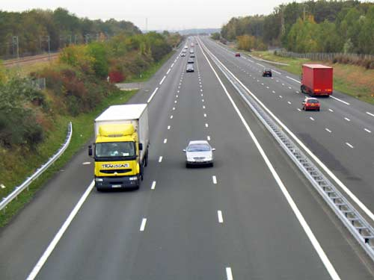
#1. Data as an infrastructure

Slide 4
A new data governance for the state
A national chief data officer
Producing guidelines and doctrine on data governance
Building a community of departmental data officers

Slide 5
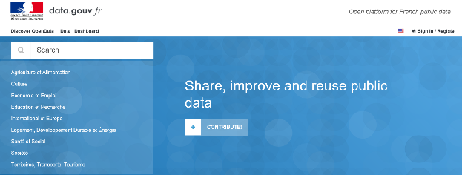
A national open data platform Data.gouv.fr
A collaborative platform open to all but especially public bodies
Which aims to foster reuse through :
Curation and datavizs
Tools to explore data
Social features

Slide 6
A strong legal framework for open data
Law 78-753 of 17 July 1978 / French FIOA
Freedom of access to administrative documents
A few limits to such a freedom
Freedom to reuse
A regulatory authority, the CADA
“Free of charge” Act
Free of charge reuse as a matter of principle
Very limited licence fees
Digital Republic Act
Open data by default : any public organization of more than 50 employees has to make available regularly updated databases and data with an economic, social, environmental interest which can be communicated to everyone
Open standards : easily reusable and usable by an automated processing system
A limited number of open licenses (free of charge) to foster dissemination

Slide 7
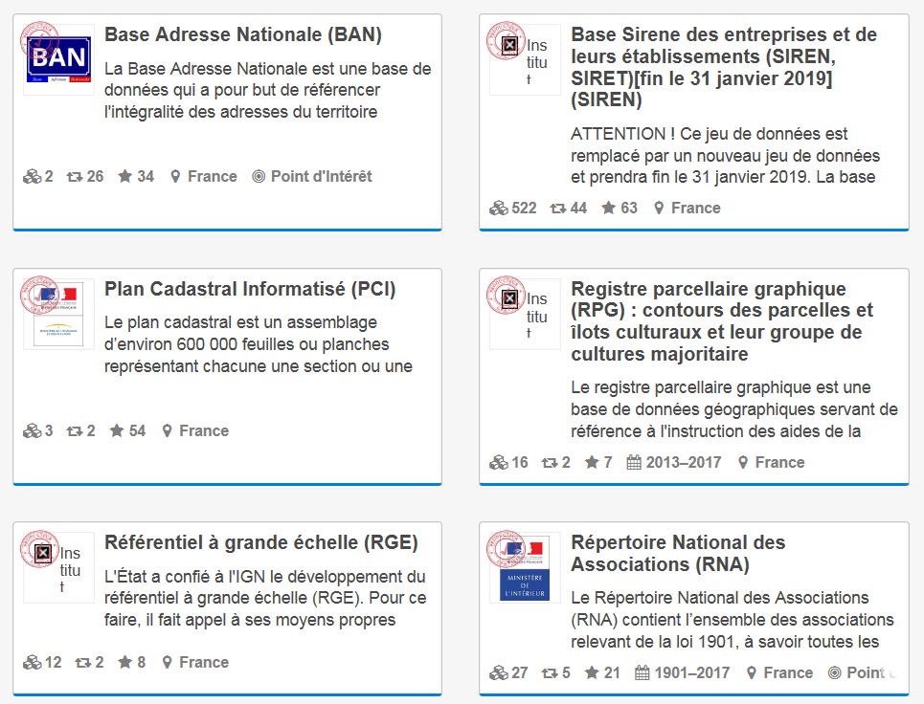
« Reference data » as a public service
Recognizing the status of « reference data » :
a common reference to name products, territories or persons …
with a high economic and social impact
already widely reused
Requiring a high degree of quality and reliability both in content and dissemination
9 data sets, including the land, company, NGO registries

Slide 8
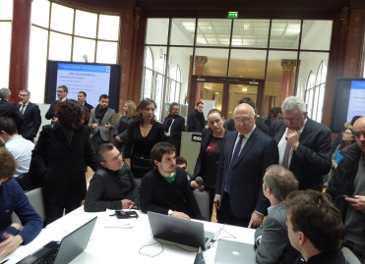
Source codes as open data
From a court ruling
A Paris Administrative Court ruled on 10 March 2016 that the software simulating the calculation of personal income tax was an administrative document subject to freedom of information / open data.
To law
Digital Republic Act included clearly source
codes in administrative documents
And a state sponsored policy
#codeimpot
Open source contributing policy for public organizations

Slide 9
#2. Opening public algorithms

Slide 10
A new legal framework for public algorithms
A new problem : code is law
Fears about automated decision making (ie. university affectations, tax calculation etc.)
A new legal framework
Digital Republic Act
Transparency rules for algorithms used to make individual decisions:
mention in each decision
right to explanation: the person can get detailed information on how the algorithm was implemented for his specific situation and with which data
online publication of the rules of the main public algorithms
French implementation of GDPR
Automated decision making allowed for administrative decisions when:
right to human intervention
transparency
control of algorithm / rules-based algorithms

Slide 11
A tough implementation
Getting better understanding of the situation
What is automated decision making? Which public administration use algorithmic treatment? Who is developing the algorithm? Can we access it?
Making sure the existing practices are compliant with the law
With the new transparency framework
With the relevant legislation: does the code correspond to the legal text? Do we have to be more specific in the text?
Developing best practices
Ex post:
Is transparency enough? Should we share the source code or more explanations ? How to best explain? Is it worth it without data?
Is auditing the solution? How?
Ex ante:
Where should we position the developing team?
How to develop algorithms that are accountable « by design »?

Slide 12
Making accountable AI through open data
Preparing the next public algorithms generation
Deep learning benefits
Efficient private sector algorithms
rule-based algorithm will be challenged rapidly
Open training datasets
Non discriminatory
Diverse
For basic AI functions: text, image
And more critical public services
Open testing frameworks
A few projects
Open algorithms

Slide 13
Thank you ! www.etalab.gouv.fr www.data.gouv.fr
Maud Choquet : maud.choquet@modernisation.gouv.fr
Amélie Banzet : amelie.banzet@modernisation.gouv.fr

